Slide 1
Final Project Proposals
Ikra Rashid

Slide 2
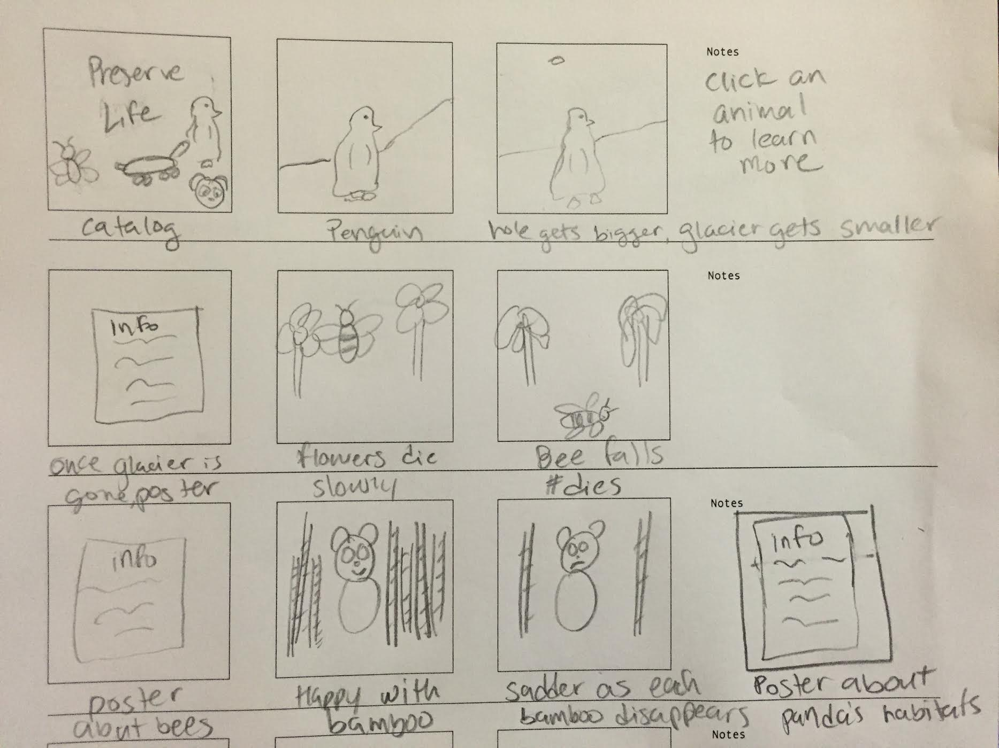
Endangered Species

Slide 3
Endangered Species
Goal: Raise awareness for endangered species
Inspiration: Bryan James: Link
Art: Roger Peet: Link
Influence: Animal Planet: Link

Slide 4
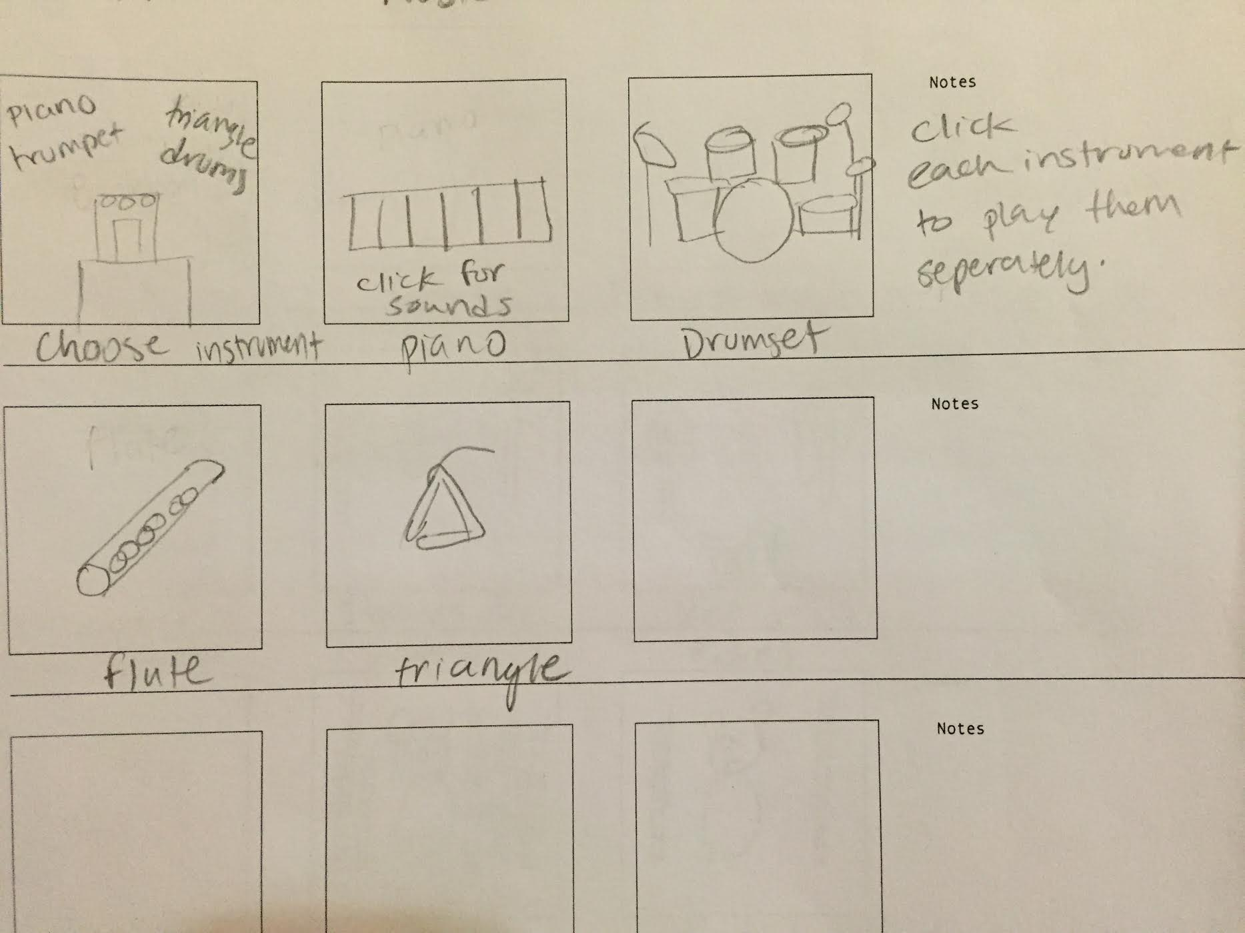
Music

Slide 5
Music
Goal: Nostalgic times to when we played the recorder, can now experiment with other instruments
Inspiration: Kyle McDonald: Link

Slide 6
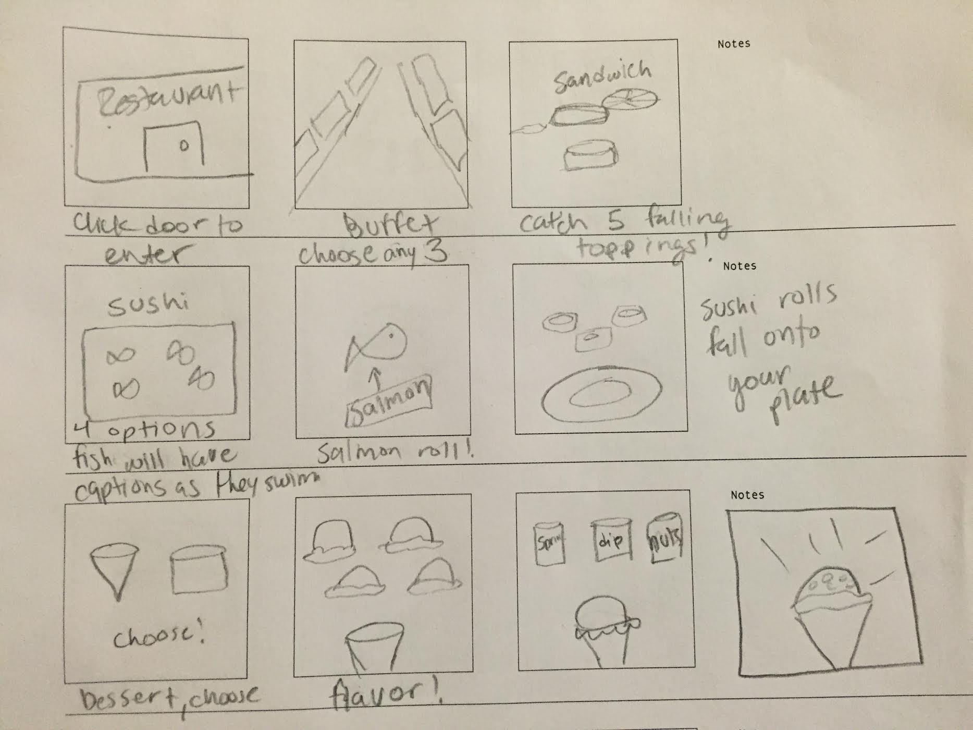
Buffet

Slide 7
Buffet
Goal: Give the user an interactive experience of a buffet where they can eat a sandwich, their choice of sushi (fresh), and their choice of dessert
Inspiration: Quaser - Field : Link
IBM: Program uses “math, chemistry, and vast quantities of data to churn out new and unusual recipes.”

Slide 8
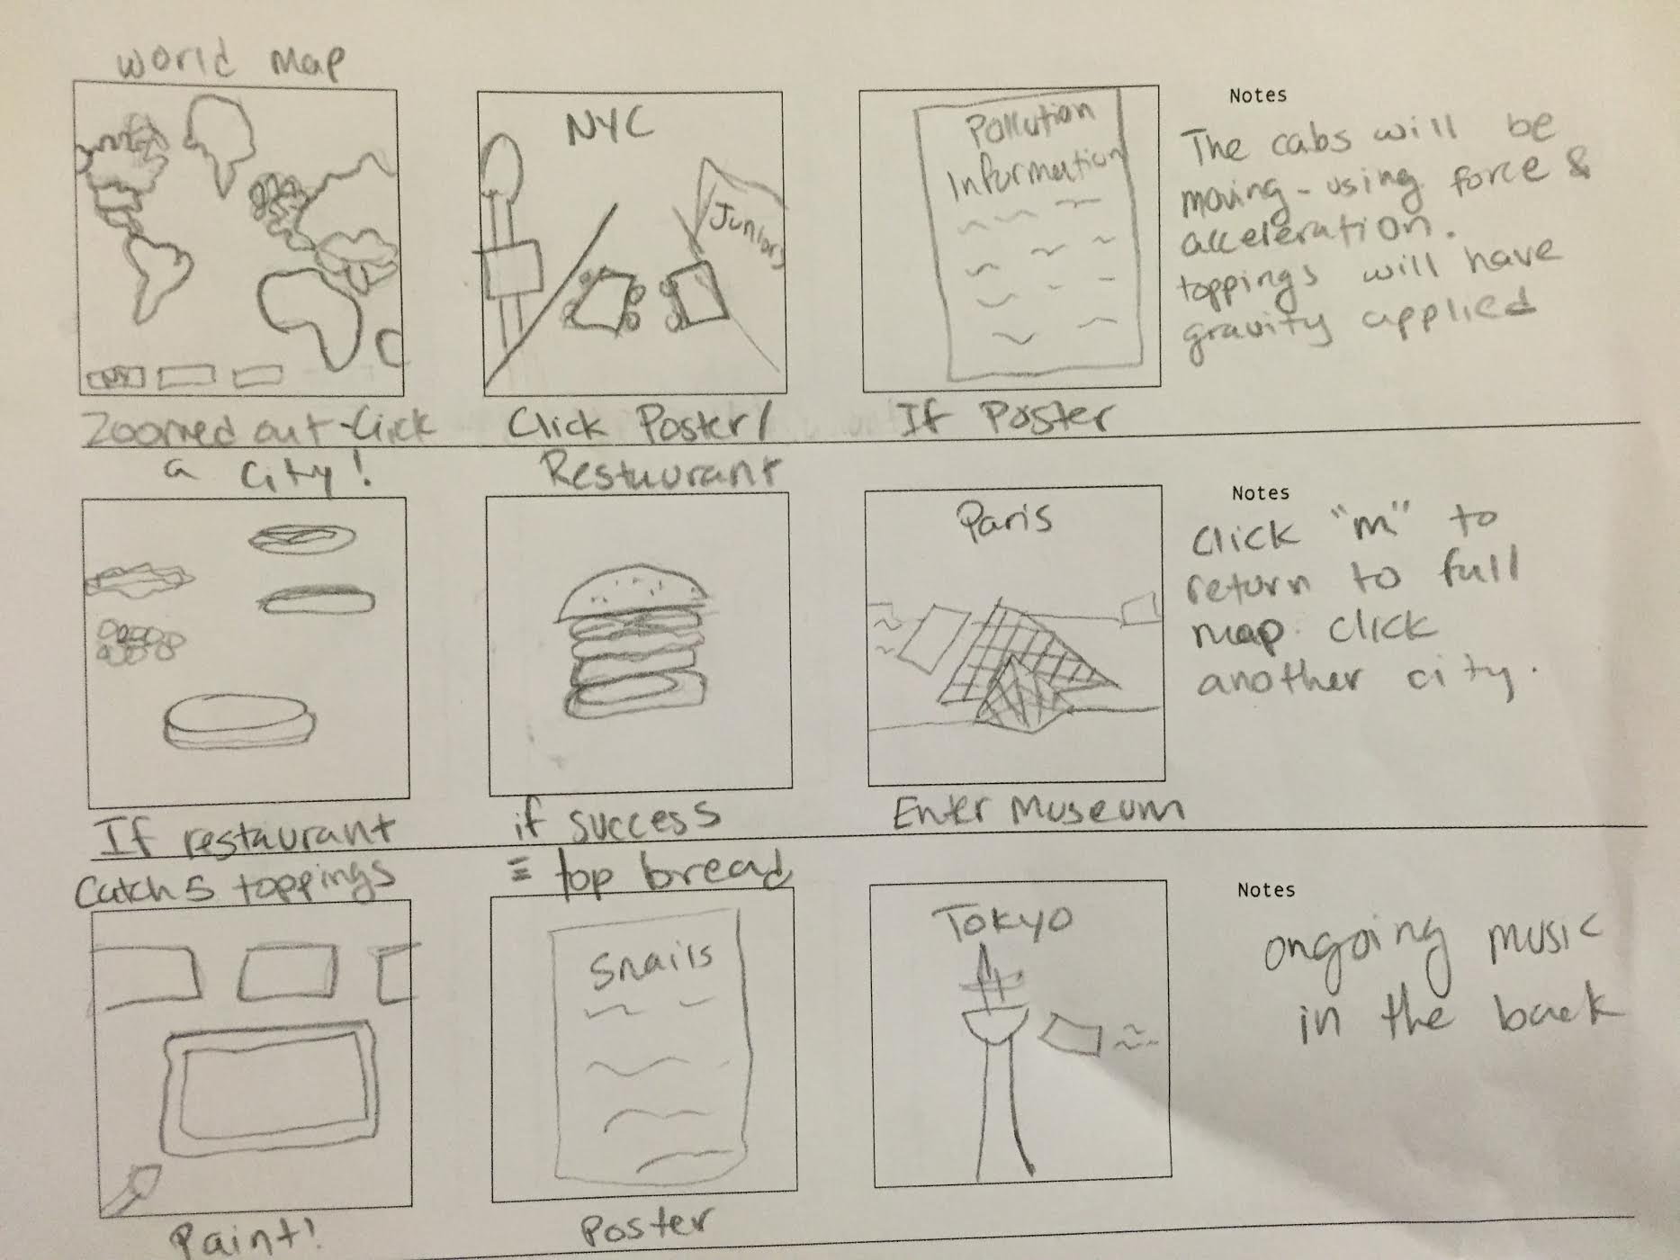
Duality

Slide 9
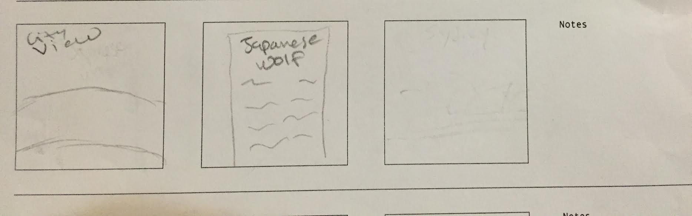
Duality

Slide 10
Duality
Goal: We enjoy attractions, different countries and their cities. We often forget about the major problems in those cities. We only look at the pretty things. Although the user can visit the city, they can also click to learn more about the endangered species from that area. Mixture of all three ideas: endangered species, sound, food.
Inspiration: All the links mentioned. Midterm Project.

